Slide 1
Interface diagram
Software engineering
[00. 00. ‘13 / ***]
표상웅
정진수
고민주

Slide 2

Contents
1. Interface diagram

Slide 3

Interface diagram

Slide 4
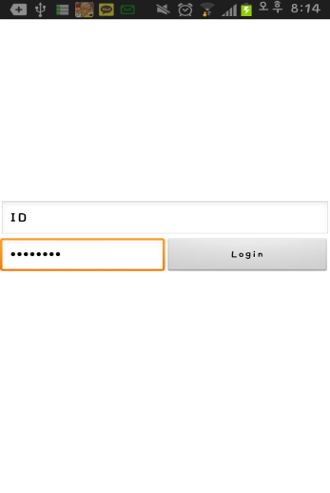
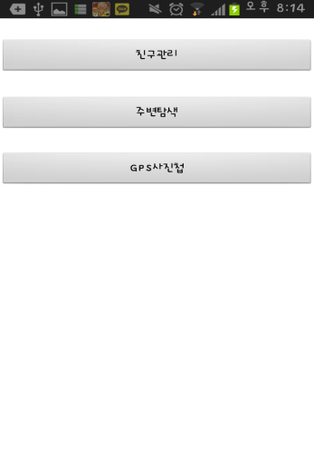
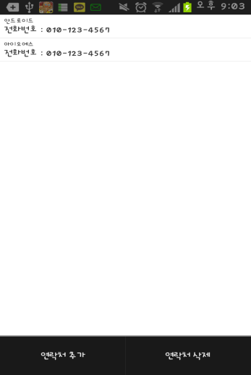
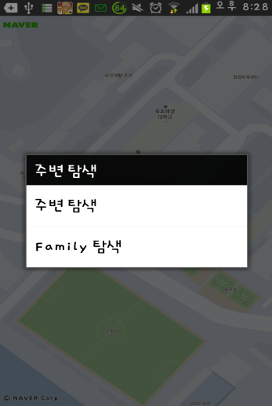
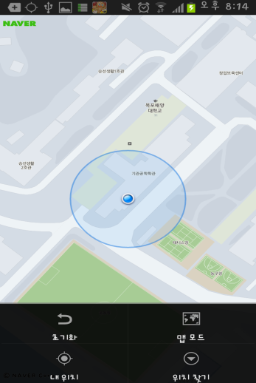
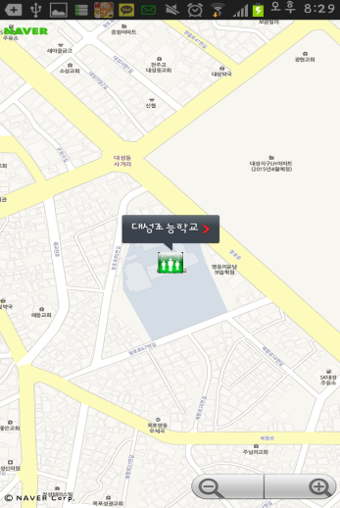
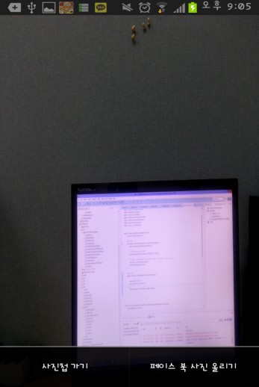
Interface diagram
Login
Menu
Sub Menu 1
Sub Menu 2
Sub Menu 2.1
Sub Menu 3
Sub Menu 3.1

Slide 5
Thank you

